Slide 1



Real Estate Fundamentals
Owning or selling a piece of the American Dream

Slide 2
Should I buy a house or rent?
Have reliable income, good credit, and documentation to verify your savings.
Can afford at least a 3% and other closing
Want to build equity and be eligible for homeowner tax breaks and credits.
Have the time and money required for home maintenance and improvement projects.
Have an adequate cash reserve to withstand a loss of job, illness, or other financial setback.
Are planning on staying in your home for at least five years.

Slide 3
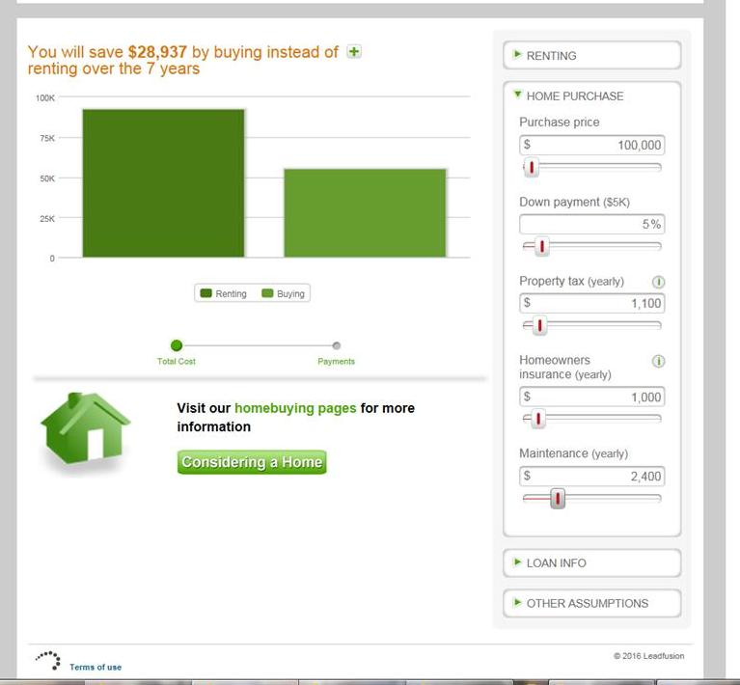
$92,575
$65,584

Slide 4
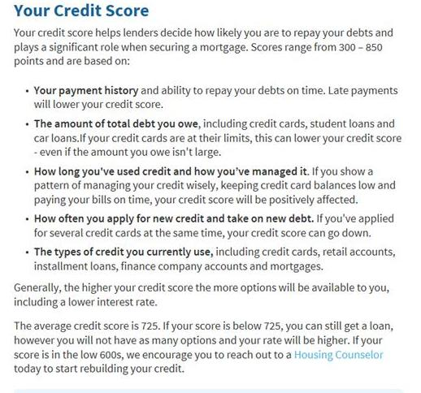

Slide 5
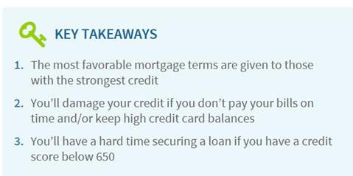
Protect your credit score

Slide 6
Here’s what the National Associaton of REALTORS® says about buying a home:
Are you ready to become a homeowner?
Whether you’re becoming a homeowner for the first time or you’re a repeat buyer, buying a house is a financial and emotional decision that requires the experience and support of a team of reliable professionals.

Slide 7
Find a REALTOR®!
In the maze of forms, financing, inspections, marketing, pricing, and negotiating, it makes sense to work with professionals who know the community and much more. Those professionals are the local REALTORS® who serve your area.

Slide 8
Get pre-approved for a mortgage.
Most first-time buyers need to finance their home purchase, and a consultation with a mortgage lender is a crucial step in the process. Find out how much you can afford before you begin your home search.

Slide 9
Look at homes
A quick search on a website like realtor.com will bring up thousands of homes for sale. Educating yourself on your local market and working with an experienced REALTOR® can help you narrow your priorities and make an informed decision about which home to choose.

Slide 10
Choose a home
Choose a home that meets your needs and priorities, that you’ll be happy living in it for years to come, but could be resold easily if the need arose.

Slide 11
Get a loan to finance your home
The cost of financing your home purchase is usually greater than the price of the home itself (after interest, closing costs, insurance and taxes are added). Get as much information as possible regarding your mortgage options and other costs from your lender.

Slide 12
Have your REALTOR® fill out a sales
contract
Once you choose the home you want and know that financing is available, your REALTOR® will fill out a sales contract to negotiate with the seller on your behalf.
You will need to make an earnest money deposit at the time you write the offer to purchase. This deposit is an advance on the money you need to close the home and it will be credited back to you at closing.
The offer will be presented to the seller’s agent and may be accepted as is, counter-offered or rejected. Once both parties have reached an agreement, the contract is signed and it becomes binding.

Slide 13
Get insurance
Real estate insurance protects owners in the event of catastrophes such as fire, tornado and flood. Because the lending institution takes the home you are financing as collateral for the repayment of the loan (you mortgage your home), the lender REQUIRES that the home be insured so that there isn’t any loss in their collateral in the event you default on the loan.

Slide 14
Go to the closing
The closing of the home usually takes place at an attorney’s office. The terms of the negotiated contract are fulfilled—the buyer receives the deed to the home and the seller receives the price that the parties agreed upon. Any issues that were negotiated as part of the contract—repairs or other issues—should be fulfilled prior to the closing. The buyer brings to closing any funds other than the amount financed.
Once the seller signs the deed, presents it to the buyer and it is accepted by the buyer, transfer of the property has taken place.

Slide 15


Slide 16

Episode 1: Knowing when you’re ready

Slide 17

Episode 2: Mortgage Lending 101

Slide 18

Episode 3: The Search

Slide 19

Episode 4: The Offer

Slide 20

Episode 5: Closing the Sale

Slide 21
Real Estate Contracts
Contract law:
  A contract is a voluntary agreement or promise between legally competent parties supported by legal consideration for a legal act

Slide 22
Real Estate Contracts
Elements of a valid contract
  Offer and acceptance
  Consideration
  Consent
  Legal purpose
  Legally competent parties

Slide 23
Real Estate Contracts
Termination
  Fulfillment of contractual agreement
  Breach
  Specific performance
  Mutual agreement
  Operation of law
  Rescission

Slide 24
Land-Use Controls and
Property Development
The comprehensive plan is done by local planning boards and elected officials based on:
  Land use
  Housing needs
  Movement of people and goods
  Community facilities and utilities
  Energy conservation

Slide 25
Land-Use Controls and
Property Development
Zoning ordinances
  Buffer zones
  Bulk zoning
  Aesthetic zoning
  Incentive zoning
  14th Amendment and Takings Clause (5th Amendment)
  Taking

Slide 26
Land-Use Controls and
Property Development
Zoning permits
  Zoning hearing board
  Nonconforming use
  Conditional use/Variance

Slide 27
Careers in Real Estate
Must be 18 years old
Must be a resident of Mississippi
Must complete 60 hours of real estate education from a certified education provider
Must fill out an application with the Mississippi Real Estate Commission
Must take and pass the MREC required licensing exam
Salesperson license must be held by a Mississippi broker
Must show proof of Real Estate Errors & Omissions insurance within 30 days of receiving license
Must complete an additional 30 hours of real estate education within one year of receiving license

Slide 28
Basics of being a real estate licensee
Independent contractors and are classified as self-employed
Income is commission-based
There is significant costs of doing business
Cannot sale without a license and license must be renewed
Must be motivated, self-disciplined and willing to work hard

Slide 29
Careers in Real Estate
Salesperson or Broker
Residential
Commercial
Land
Mortgage lender
Property manager
Home inspector
Appraiser

Slide 30

Mississippi REALTOR® Institute

