Slide 1






LEADING YOU HOME
BY REALTOR
LMAR 22

Slide 2


OBJECTIVE
Home Buyer education that will provide guidance to young adults on the topics of:
  ESTABLISHING CREDIT
  RENTING A HOME
  BUYING A HOME
  SELLING A HOME
Ultimately the objective is to teach young adults how real estate can help them build wealth.
Notes:
Presenter will introduce him/herself to the audience and state the objective of presentation.

Slide 3






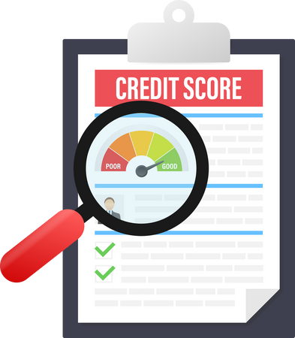
LEADING YOU HOME
CREDIT CHECK
Notes:
Today we will begin with talking about credit.
Our session today will provide you with an understanding of how credit and finances will play in a role in all real estate transactions whether it be a rental property or a home you will purchase. In fact, credit will play a major role in your life and affect many other things besides housing.
Does anyone have an example of other areas where your credit score could impact you throughout your life?
(Car loans, Furniture, Credit Cards, Housing, Insurance, Car Rentals, etc)
By the time we complete this session and cross the finish line, you will have the necessary tools to become not only a successful homeowner, but you’ll also be ready for all the other financial things you will encounter as you begin your adult life.

Slide 4

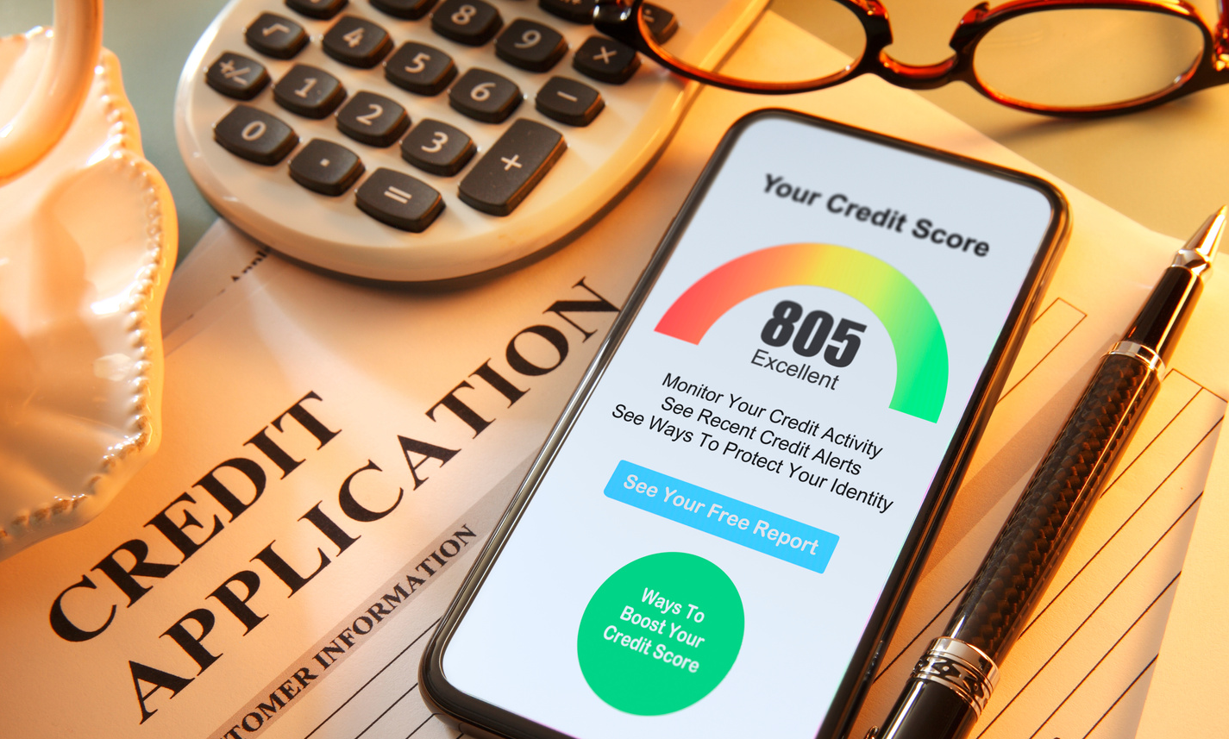


DEFINITION:
What is credit?
A) Definition (Webster’s definition) - the ability of a customer to obtain goods or services before payment, based on the trust that payment will be made in the future
Example:
You borrow money from your father and agree to pay him back next Friday.
In order for credit to work, Dad has to believe that you can and will make that payment next Friday or other terms both parties agree to.
Notes:
Read definition and example provided. (Optional: insert personal story regarding your first credit experience)
Share with the audience that lenders, credit cards, loan providers, cell phones, etc report payment history to the “Credit Bureaus” and that the credit bureau will keep track of a person’s payment history. The credit bureaus issue a credit score. The higher the score the better the likelihood that the borrower will repay the debt.
The higher the score the better financing terms a person will receive.

Slide 5






Did you know?
Consumer Credit
Renting
Even if you're renting your landlord may check your credit to see if you would be a good tenant?
Insurance
The better your credit is the better quote you will receive on your homeowners or vehicle rate?
Mortgages
The higher your credit score the lower
your mortgage rate will be?
Notes:
Go through each ‘Did You Know’ highlighting the definition of the bold words.

Slide 6








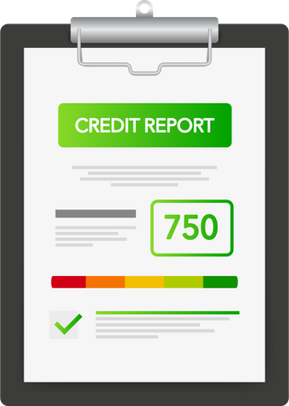
Lower Mortgage Interest Rate
Lower Mortgage Interest Rate
Easier to get Pre Approved
Easier to get Pre Approved
Landlords are typically more likely to approve your application
Landlords are typically more likely to approve your application
Cheaper insurance rate
Cheaper insurance rate
Cheaper/no high risk utility deposit
Cheaper/no high risk utility deposit
Why Credit is
important
Notes:
Go over slide with audience
Poll The Audience:
Ask the audience to give an example of how a good credit score could impact them on something they plan to do after high school.
Ask the audience to then give an example of how a poor credit score could impact them on something they plan to do after high school.

Slide 7



START NOW
WAYS TO ESTABLISH CREDIT:
You must be 18 yrs. of age
Apply for a secured loan from your local bank
Apply for a secure credit card and keep balance below 21% of available credit limit
What if I don't have
any credit?
Monitor your credit to ensure no fraud is taking place
Ask a family member you trust to add you as authorized user on a credit card
Notes:
Go through slides explaining steps in detail.
Share ways a person can establish credit:
Have a cell phone in their name
Become an authorized user on a family/friend’s credit account. Keep in mind this can be both helpful and harmful to your credit as your credit will reflect that creditor’s account.
- Open a secured credit card account (THIS ONE IS HIGHLY recommended). They can do this often with their own bank and for as little as a couple of hundred dollars. Explain what a secured loan is and how it works to improve credit score.

Slide 8


"Good Credit"
"Bad" or No Credit
Auto Loan Amount
$20,000
Auto Loan Amount
$20,000
Auto Loan Term
5 Yrs.
Auto Loan Term
5 Yrs.
Interest Rate
6.0%
Interest Rate
26.0%
Monthly Payment
$387
Monthly Payment
$599
Payment Difference
$212
Total Interest
Total Interest
$3,199
$15,929
Interest Difference
$12,730
Notes:
(Visual of Credit Comparison)
Let’s take a look at how obtaining the same car loan with good credit versus bad credit could impact you.

Slide 9


Major Factors:
Maintaining Credit
Length of Credit History
15%
Make payments on time
Amounts Owed
30%
Credit card utilization
Credit Mix
10%
Length of credit
New credit
New Credit
10%
Type of credit
Public Records
(Ex. Bankruptcy)
Payment History
35%
Number of credit
inquiries
Notes:
Go through the major factors that affect your credit and refer to pie chart as visual.
Optional Game (See game document)
Objective:
Allows the audience to visualize the importance of having good credit.
How To Play: Have students draw a card from a stack (to be made by presenter) that will have a credit score and job title with average salary for that profession. Example: Nurse $47,000. From here create scenarios where students will have to budget a household including buying a home and having a car (give interest rates based on score given. This number doesn’t have to be perfect since this is just a visual and all variables can’t be considered. You can also use a mortgage calculator to get mortgage payment. One example of a mortgage calculator - https://www.fairwayindependentmc.com/Resources/Fairway-Calculators/Mortgage-Calculator.
Using budget rule 50/30/20, allow audience to calculate where their money is going and what type of house and car they can afford. https://www.nerdwallet.com/article/finance/nerdwallet-budget-calculator

Slide 10

LEADING YOU HOME
Should I Just Stop and Rent?
CREDIT CHECK
Notes:
Introduce next topic which is Renting.
Now that we have introduced credit. You are probably ready to rent a house or apartment.
Credit and income will be a big factor on if you are approved to secure a rental.

Slide 11


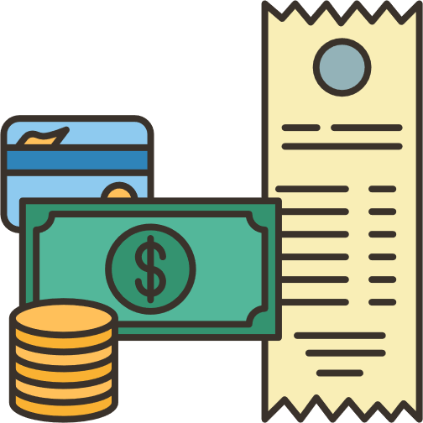
FACTS
Renting
No equity
When you pay rent, that is money you will never get back. When you pay your mortgage you are building your own equity in your home.
Payment
Your mortgage is usually cheaper than your monthly rent.
Freedom to Personalize
If you’re renting you can't do improvements or personalization without the consent of landlord.
Notes:
Read through the ‘did you know’ facts. (Optional: include personal story of your first rental experience)
Many people start out as renters. Use this time to save money, learn about maintaining a home.

Slide 12

QUALIFICIATIONS:
Income Verification
References
Co-Signer Possibility
What are the
Renting qualifications?
Application Fee
Work History
Credit and Criminal
Background Check
Notes:
Read through qualifications for renting. Define Terms (reference, co-signer, verification, credit and background check) for clarity.

Slide 13




DEPOSITS
How much money
will I need
up front?
Why is a deposit required?
What amount do I need for my deposit??
Will I get my deposit back?
That can add up to be a lot of money.
I think I am ready to buy.
Notes:
Why is deposit required? Security deposits are used to secure the landlord if lessee doesn’t fulfill lease agreement or leaves home in diminished condition. What amount of deposit do I need? Typically, deposit is one month’s rent but can be determined by lessor. Will I get my deposit back.? Typically, yes but it’s important that you discuss that before signing a lease.
A security deposit is often used to ensure the property returned in the same condition as it was rented in.
Poll The Audience:
What are some things that you think may make a landlord keep a security deposit?
What are some things you can do while renting a home/apartment to ensure you get your security deposit back?

Slide 14
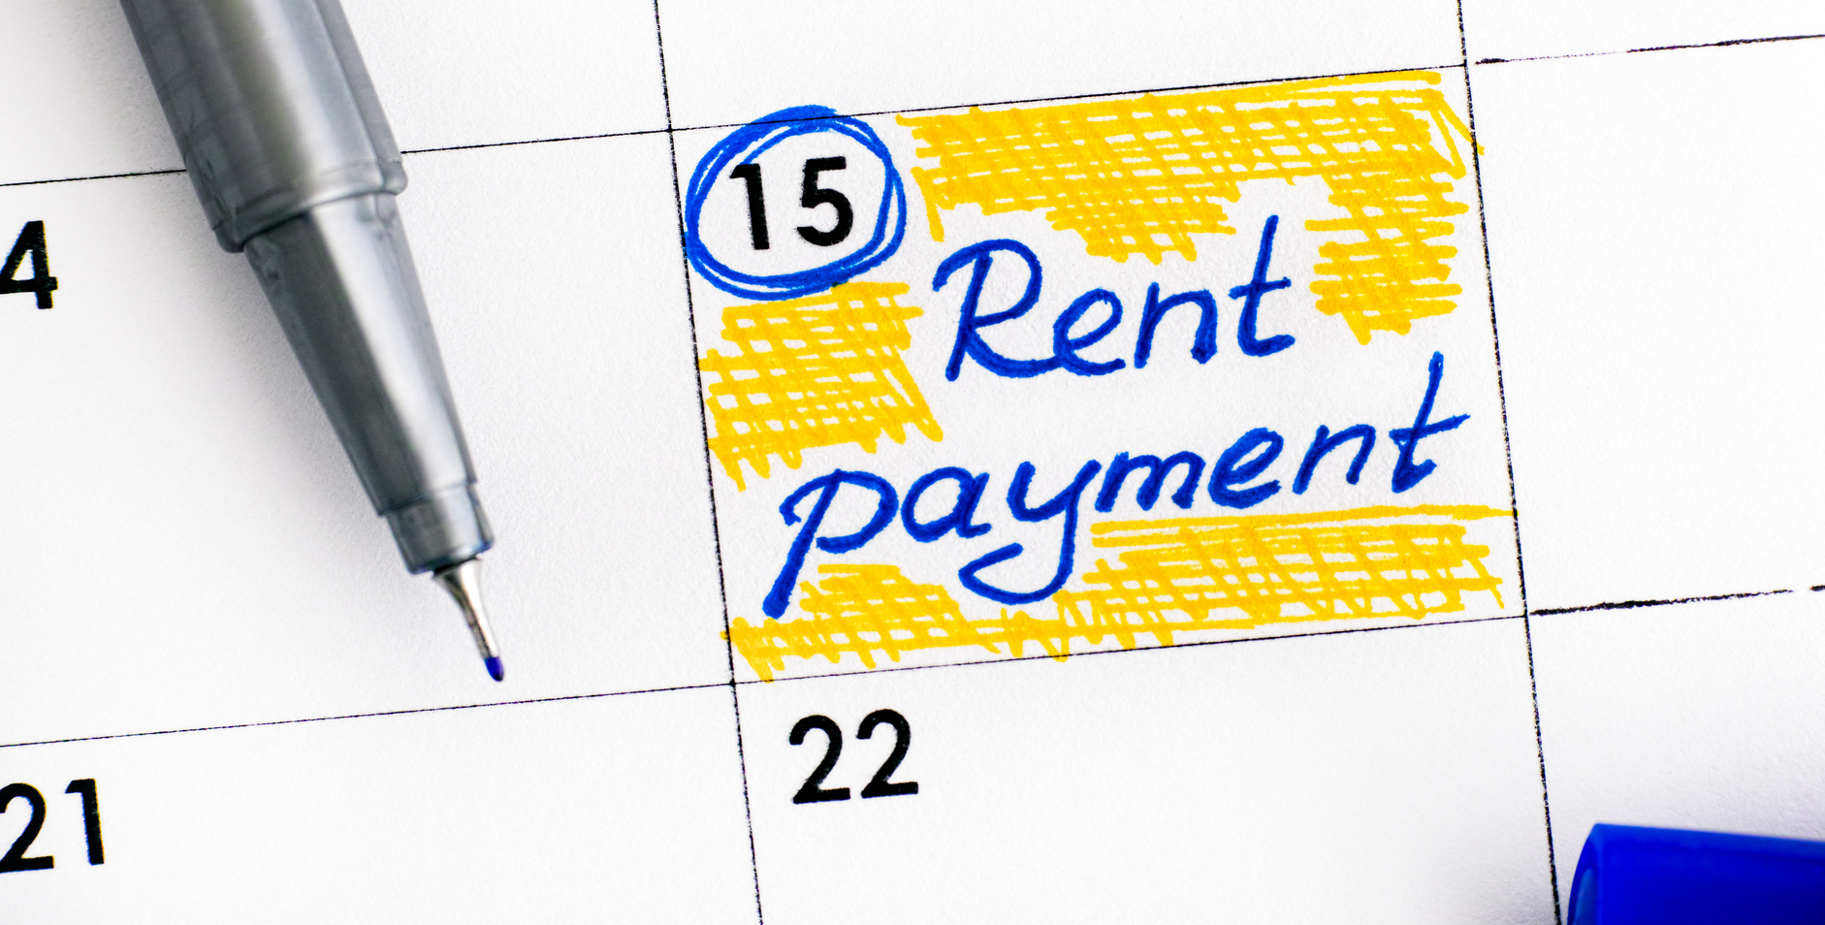



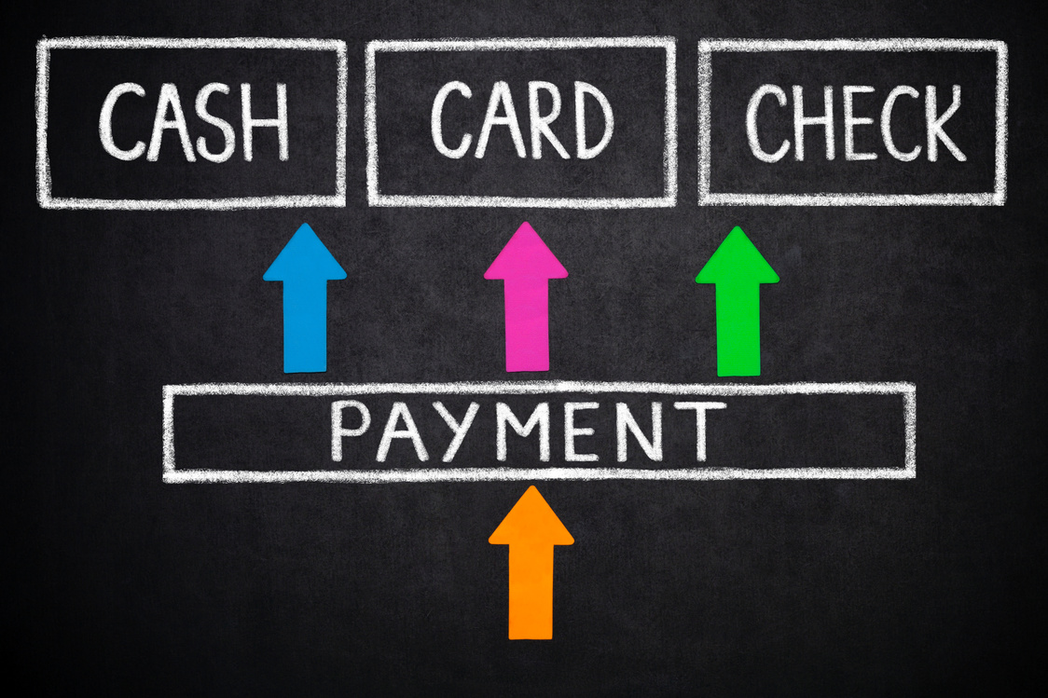


WHAT DO I NEED TO KNOW ABOUT RENTAL PAYMENTS?
Be aware of due dates and grace periods
Be on time
MONTHLY RENTAL PAYMENTS
Know what methods are accepted and where they can be made
Watch out for late fees
Be prepared for rent increase at end of term
Notes:
Read through slide bullet points.
Never pay rent with cash.
Use a personal check, cashier check or money order and keep a copy of all receipts.

Slide 15

THINGS TO KNOW:
Know the duration and terms.
Who is allowed to live with you?
Are pets allowed?
Who is responsible for what?
Lease
Agreements
Are visitors allowed?
101
Landlord communication?
Lease termination and penalty?
Notes:
Read through slide bullet points. Optional Resource: https://www.hud.gov/states/mississippi/renting/tenantrights
Renting a property will come with some rules. Be sure you are fully aware of all rules.

Slide 16



LEADING YOU HOME
Should I Just Stop and Rent?
Fun Fact:
Renting a home doesn't build
any equity for you
Buying a Home Can create future wealth
CREDIT CHECK
Notes:
There will come a time when you will be ready to take steps towards homeownership!
Nothing will feel better than knowing you own your own home.
Poll the Audience:
What do you think some of the benefits will be to homeownership?
Do you know the average number of homes a person lives in in an owned home versus living in a rental home (7 years owned versus 1 year rented)

Slide 17



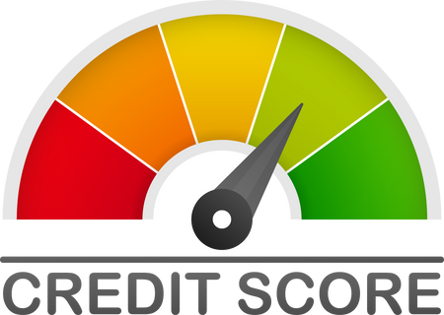
Did you know?
Buying a home
Equity
By owning a home you are constantly building equity in your home every time you make a payment? Renting does not build equity for you?
Improves Credit
The better your credit is the better quote you will receive on your homeowners or vehicle rate?
Freedom to Personalize
You can make improvements to personalize the home you own?
Notes:
Read through the bullet points
Explain the term equity.
If you have a home that is worth $200,000 and you owe $140,000 the equity of the house will be $60,000
Poll The Audience
How much equity will you have a $1200 a month rental at the end of a 1 year lease? (None – no equity for rentals)

Slide 18



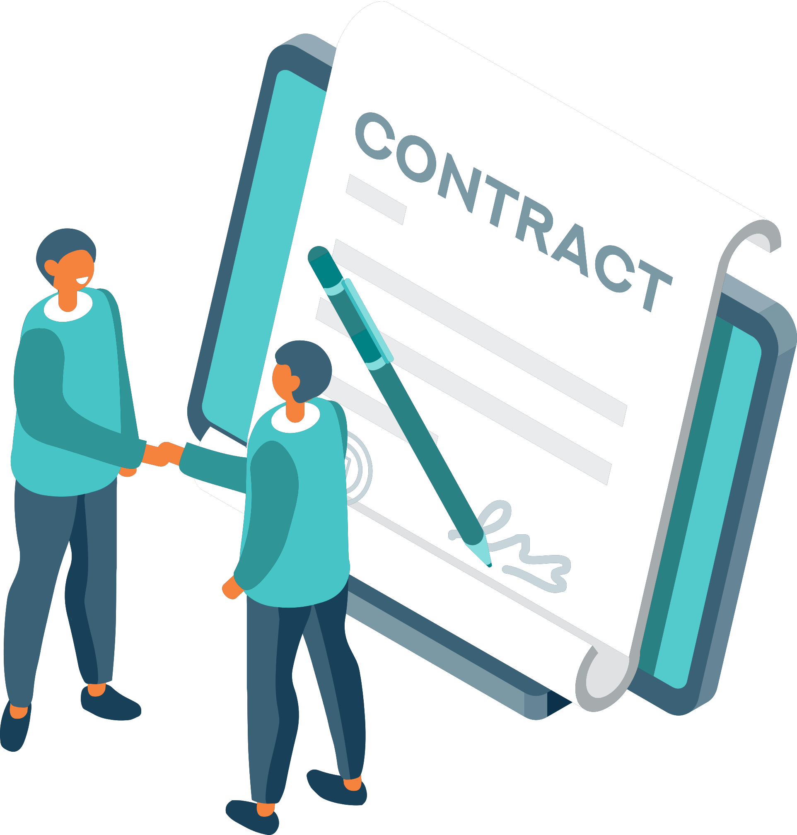


SERVICES:
KNOWLEDGE
They have an extensive amount of knowledge to get you through the process, forms, contracts, etc.
SEARCHING POWER
REALTORS® are equipped with the latest tools to help find the perfect house.
Why use a REALTOR® to purchase?
NEGOTIATING CONTRACTS
Let's face it, when it comes to negotiating a contract, it can be challenging. Rest assured your agent will have your back and guide you through that.
REALTOR®
A member of the National Association of REALTORS® who acts as an agent for the sale and purchase of buildings and land
YOUR FRIEND
Your REALTOR® will be your friend, consultant, data analyst and more, all rolled into one person.
Notes:
Read through the bullet points expressing the importance of each step
Reiterate that your profession is a REALTOR®.
“When I introduced myself I told you I am a REALTOR®”
Poll The Audience
Does anyone know what a REALTOR® does?
Does anyone know a REALTOR®?

Slide 19




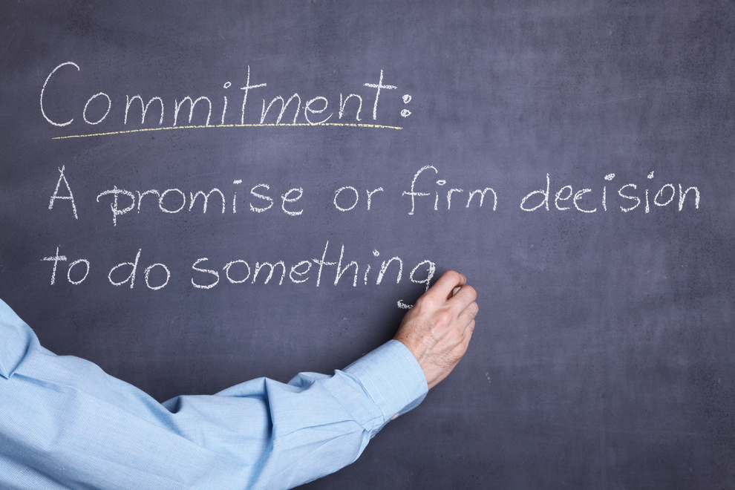
TOP REASONS:
ESTABLISH YOUR PURCHASING BUDGET
Why get
pre-approved?
ESTABLISH A RELATIONSHIP WITH A BANKER
LETS THE SELLER KNOW YOU’RE SERIOUS AND READY TO BUY!
Most sellers will not accept an offer unless you have been
pre-approved
Notes:
Read through the bullet points
The first step towards buying a home is establishing a pre-approval with the bank.
This will tell you how much money the bank will loan you for this home purchase.
Poll The Audience
How do you think credit will play a role in what the bank will loan you for a home loan?
How do you think income will play a role in what the bank will loan you for a home loan?

Slide 20


LEADING YOU HOME
Should I Just Stop and Rent?
Cash in on equity by selling
Fun Fact:
Renting a home doesn't build
any equity for you
Buying a Home Can create future wealth
CREDIT CHECK
Notes:
Introduce last step, selling a home.
Congratulations – We have now made it to the last step of the process.
When you own a home, that doesn’t mean you have to live in the same house forever. Once you have owned a home and built some equity, you may decide you want to move to a different house.
Remember the equity we discussed earlier. That will play a big role in your next home purchase.

Slide 21





Did you know?
Selling a Home
Equity
When you sell your home, you will cash in on any equity you have built through the years of paying your mortgage?
Do not be this guy.
HIRE A REALTOR®
More Profit
According the National Association, using a REALTOR® can help you achieve a higher profit than you would get by selling it yourself?
Marketing
When you hire a REALTOR®, they know how to market your home and know the avenues to get it sold fast and for top dollar?
Notes:
Read through the bullet points. (Optional: tell the story of a sale you’ve recently had)
Poll The Audience
How much equity did we say you will have after a 1 year lease of a $1200 a month rental home? (None)
How much equity will you have on a home worth $200,000 that you owe $140,000 on? ($60,000)
Now let’s use that number for a moment. Let’s say the next house you want is $300,000 – how do you think the $60,000 in equity could benefit you when you make your purchase?
The $60,000 will make it like you are financing a $240,000 house versus a $300,000 house – how would that benefit you? (lower monthly payment)
A REALTOR® will help you sell your home for top dollar.

Slide 22


Home sells faster
Home sells faster
Knows how to market the property
Knows how to market the property
Knows the market
Knows the market
Sells for more
Sells for more
Know the difference
Source: Listwithclever.com
Notes:
Show and go through bullet points
As I mentioned before my profession is as a REALTOR®. Here are some of the things that REALTORS® do for their clients.

Slide 23



WHY YOU NEED A REALTOR®
NETWORK
REALTORS® have a lot of connections such as lenders, inspectors, appraisers, and buyer contacts to help expedite the sale.
COMPARABLE MARKET ANALYSIS
REALTORS® will do a free market analysis to make sure your house is priced right from the start to get it SOLD FAST!
Why use a REALTOR®?
NEGOTIATING CONTRACTS
It's what we do! Hiring a REALTOR® can help you navigate those long contracts and legal processes to make sure you're protected when it comes to negotiating offers.
The typical FSBO home sold for $260,000 compared to $318,000 for agent-assisted home sales.
CLOSING PROCESSES
REALTORS® will help you during the entire process to make sure you get to close on time!
SOURCE: NAR
Notes:
Read through bullet points
REALTORS® can help you find homes, secure financing, negotiate terms and prices, sell houses and be a resource to you during your life as a homeowner.

Slide 24

LEADING YOU HOME
Should I Just Stop and Rent?
Cash in on equity by selling
Fun Fact:
Renting a home doesn't build
any equity for you
Buying a Home Can create future wealth
Thank you for joining on my
race to financial literacy
CREDIT CHECK
Notes:
Congratulate audience on taking class and give recap.
Give the audience some advice on how to become homeowners.
Open a bank account and start saving money now. Even $10 a week after a few years will be a big impact on buying a home.
Pay bills on time
Share this information with their parents and ask parents advice on how to implement the two suggestions above.
If anyone you know ever needs help - or you yourself ever needs real estate help or just has questions, I am only a phone call away.
Good luck to you in the future!

