Slide 1
MREC
MISSISSIPPI REAL ESTATE COMMISSION
Notes:
Today we will discuss the Mississippi Real Estate Commission, or MREC, and some possible questions you may have regarding MREC.

Slide 2
  THE MISSISSIPPI REAL ESTATE COMMISSION (MREC) OVERSEES THE RESIDENTIAL AND COMMERCIAL REAL ESTATE INDUSTRY IN MISSISSIPPI, LICENSING BROKERS AND SALESPERSONS.
  IT ENSURES PROFESSIONAL AND ETHICAL TRANSACTIONS THROUGH COMPREHENSIVE TESTING AND CONTINUING EDUCATION FOR LICENSEES AND POTENTIAL LICENSEES.
  MREC ENFORCES STATE LAW, AND FURTHER PROTECTS CONSUMERS WITH A SET OF RULES, INVESTIGATING RULE VIOLATIONS AND UNETHICAL PRACTICES.
  IT ALSO MONITORS REAL ESTATE COMMERCE BETWEEN LICENSED BROKERS IN MISSISSIPPI AND OTHER STATES.
MREC
Notes:
The Mississippi Real Estate Commission (MREC) has authority over the real estate industry in the State of Mississippi, licensing all real estate brokers and salespersons.
MREC works to ensure that all real estate transactions are performed in a professional and ethical manner.
Potential licensees undergo comprehensive testing and licensees are subjected to continuing education requirements.
MREC protects the consumer by setting forth a set of rules for its licensed members, and they are responsible for investigating reports of rule violations.
They also investigate reports of violations of state law or statute.
The Mississippi Real Estate Commission also monitors real estate commerce taking place between brokers licensed in Mississippi and those in other states.

Slide 3

WHO ARE THEY?
5 COMMISSIONERS
  FOUR (4) CONGRESSIONAL DISTRICTS
  ONE (1) MEMBER-AT-LARGE
  ADMINISTRATOR AND STAFF
Notes:
MREC has five Commissioners who are appointed by the Governor and must be confirmed by the Senate.
The Commissioners serve 4 year terms.
The Administrator is not a Commissioner.
The Administrator is staff, and responsible for the operations of the Commission office and supervision of the staff members serving the Commission.

Slide 4

MREC'S PRIMARY MISSION
TO PROTECT THE PUBLIC
Notes:
The main mission of the Mississippi Real Estate Commission is to protect the public.
To accomplish this mission, MREC issues licenses, monitors completion of the required number of continuing education hours, receives complaints about licensees and disciplines those licensees when they are found to be in violation of state statute or MREC rule.

Slide 5
WHO DOES MREC OVERSEE?
MREC OVERSEES ALL REAL ESTATE LICENSEES AND LICENSED HOME INSPECTORS.
Notes:
By state law, MREC oversees all real estate licensees and home inspectors.
As of July 1st of 2023, MREC no longer has jurisdiction of licensed appraisers.
That function is now being handled by the Mississippi Appraisal Board, which became a separate Board on July 1st of 2023.

Slide 6
30 HOURS OF POST-LICENSE EDUCATION ARE REQUIRED WITHIN 1 YEAR OF OBTAINING A NEW SALESPERSONS OR BROKERS LICENSE.
POST-LICENSE AND CONTINUING EDUCATION (CE)
THE LICENSEE IS RESPONSIBLE FOR THEIR CONTINUING EDUCATION HOURS AND GETTING THEM COMPLETED BEFORE THE LICENSE IS DUE FOR RENEWAL.
IF THE LICENSEE FAILS TO HAVE THE CORRECT AMOUNT OF CE NEEDED PRIOR TO THE EXPIRATION DATE, HIS/HER LICENSE IS AUTOMATICALLY PLACE ON INACTIVE STATUS.
EDUCATION MUST BE FROM AN MREC-APPROVED SOURCE.
IN-PERSON, VIRTUAL CLASSROOM OR ONLINE.
16 HOURS OF CE ARE NEEDED EVERY 2 YEARS.
Notes:
After you are licensed, MREC requires two types of education in order to keep that license.
Within 12 months of receiving your temporary license, MREC requires a 30 hour post-license course.
If the required post-license course is not completed within 12 months, your temporary license shall automatically be placed on inactive status by MREC and your file will be permanently closed on the first of the following month.
16 hours of CE will need to be completed every 2 years in order to keep your active license.
As an Independent Contractor, it is the Licensee’s responsibility to take post-licensing courses and CE and make sure you complete the required number of hours.

Slide 7
WHAT IS AN MREC COMPLAINT?
  An MREC Complaint is filed when it is thought that a State Law or MREC Rule is broken by a real estate licensee or home inspector.
Notes:
As we’ve said, MREC issues licenses and monitors completion of all of the required hours of education.
But what about the MREC disciplinary process?
First of all, an MREC complaint can be filed when it is believed that state law or a Real Estate Commission Rule has been violated.

Slide 8
WHO CAN FILE A COMPLAINT?
ANY LICENSEE OR CONSUMER OR THE COMMISSION ITSELF. ANYONE MAY FILE A COMPLAINT WITH MREC. EITHER THE LICENSEE OR THE CONSUMER MAY FILL OUT THE FORMS, OR THEY MAY RETAIN AN ATTORNEY TO DO IT. OF COURSE, MREC MAY, ON ITS OWN MOTION, OPEN AN INVESTIGATION AND FILE A COMPLAINT.
Notes:
Anyone can file a complaint including licensees and members of the public.

Slide 9
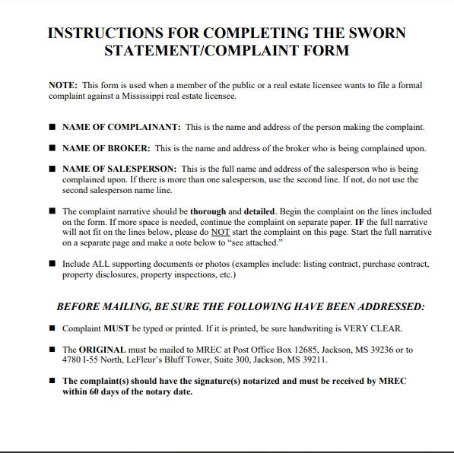
THE COMPLAINT PROCESS FOR THE PUBLIC:
VISIT MREC.MS.GOV/FORMS
AND FOLLOW THE STEPS to FILE A
COMPLAINT.
Notes:
Members of the public can file a Complaint with the Commission.
The Real Estate Commission has developed a specific process for the public to use to file a complaints against a licensee.
[***Read above form for instructions to file and also review details of the form.]

Slide 10
THE COMPLAINT PROCESS FOR LICENSEES:
DISCUSS WITH YOUR BROKER
VISIT MREC.MS.GOV/FORMS
AND FOLLOW THE STEPS to FILE A
COMPLAINT.
Notes:
Licensees can also file complaints against each other.
The Real Estate Commission also has a specific process for licensees to file a complaints against a another licensee.
[***Read above form for instructions to file and also review details of the form.]

Slide 11

WHAT TO DO IF A COMPLAINT IS FILED AGAINST YOU:
  MREC RECIVES THE COMPLAINT AND NOTIFIES ALL AGENTS AND BROKERS INVOLVED.
  ALL AGENTS AND BROKERS MUST RESPOND TO THE COMPLAINT WITH A WRITTEN STATEMENT AND ANY AND ALL DOCUMENTATION WITHIN 10 DAYS.
  AFTER REVIEWING THE INFORMATION, AND CONDUCTING AN INVESTIGATION, MREC INVESTIGATOR WILL ISSUE AN EXECUTIVE SUMMARY.
  THE LICENSEE MAY BE OFFERED AN AGREED ORDER IN LIEU OF A HEARING
Notes:
There may be a time when a complaint is filed against you. It is very important that you read it carefully and contact your broker immediately.
Be sure to follow up with any instructions you are given from the Commission.
Time is of the essence. If you do not respond in a timely manner, it could result in further consequences.

Slide 12

IF A VIOLATION IS FOUND
SHOULD THERE BE A NEED FOR A HEARING THERE ARE TWO PLACES A HEARING CAN BE HELD AND THE BROKER HAS THE RIGHT TO CHOOSE.
  MREC COMMISSION HEARING PANEL
WITH COMMISSIONERS, ADMINISTRATORS AND MREC ATTORNEY(S).
  ADMINISTRATIVE HEARING OFFICER OPTION
NEW OPTION AS OF JULY 2022
ATTORNEY GENERAL'S OFFICE WILL ASSIGN ATTORNEYS FOR OVERSEEING THE HEARING.
LICENSEES HAVE THE RIGHT TO HAVE AN ATTORNEY REPRESENT AND ACCOMPANY THEM AT ANY HEARINGS.
Notes:
If a violation is believed to have occurred and a hearing is to take place there are two options.
The first option could be a hearing through MREC. That process consists of the MREC staff presenting their findings about the complaint with the Commissioners overseeing the hearing and giving a verdict.
As of July 2022, a MAR endorsed bill was passed to allow licensees to have an alternative hearing process through the Mississippi Attorney General’s office.
If you opt for a hearing, MREC should make you aware of those two options and allow you to choose where you would like to have your hearing.

Slide 13

ADMINISTRATIVE HEARING OFFICER OPTION
UNDER THIS OPTION THE ADMINISTRATIVE HEARING OFFICER HAS THE SAME POWER AS THE REAL ESTATE COMMISSION HEARING PANEL IN REGARD TO THE OUTCOME OF THE HEARING.
Notes:
The Attorney General’s Administrative Hearing Officer hears the findings of the Real Estate Commission and the explanation of the defendant and has the authority to decide the case and any disciplinary action.

Slide 14
By state statute, MREC has the authority to oversee real estate and home inspector licensees in Mississippi.
Your attention to state law and MREC Rules & Regulations can keep you in compliance and help you care for your clients ethically and responsibly.
You may find current State Law, Rules & Regulations here:
https://www.mrec.ms.gov/license-law/
Notes:
The Attorney General’s Administrative Hearing Officer hears the findings of the Real Estate Commission and the explanation of the defendant and has the authority to decide the case and any disciplinary action.

Slide 15
RESOURCE PAGE
Welcome to the Mississippi Real Estate Commission - Mississippi Real Estate Commission (http://mrec.ms.gov)
Commissioners - Mississippi Real Estate Commission (ms.gov) Forms - Mississippi Real Estate Commission
SWORN STATEMENT/COMPLAINT FOR FILING WITH THE (ms.gov) mrec_rules_and_regulations_July_2019.pdf (ms.gov)
RULESforFinal_OLRCApprovedPDF-1.pdf (ms.gov)
MREC_LICENSE_LAW_March_14_2023.pdf (ms.gov)

